Slide 1
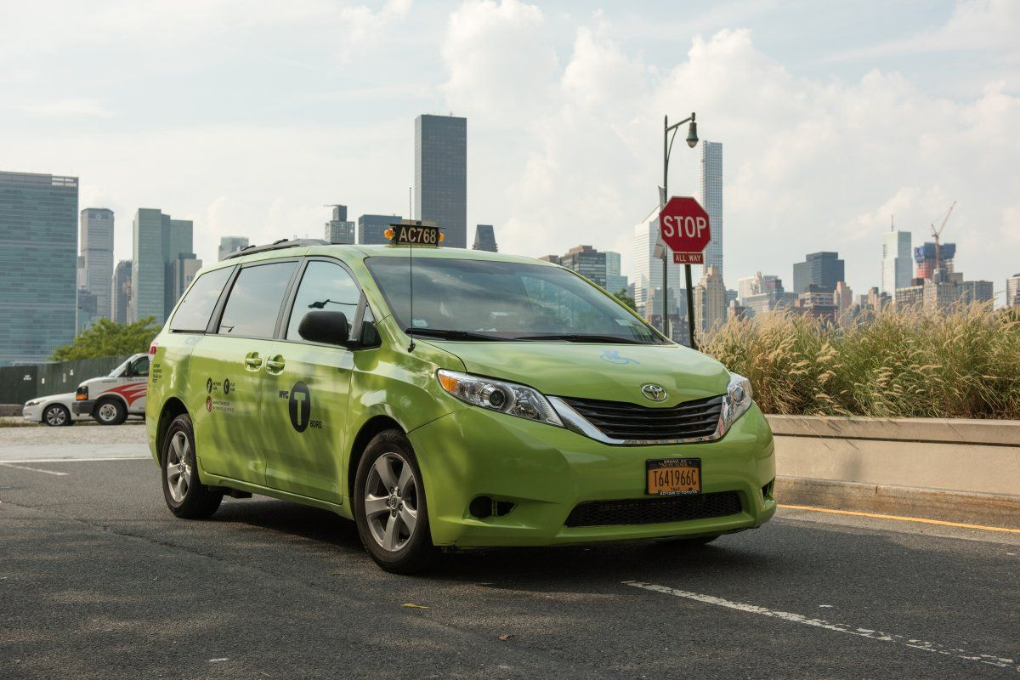
An Analysis on Green Taxis in NY (2015-09)
PLEASE NOTE:
The presentation attached works as a well-documented summary of the entire analysis. The code is the entire analysis and holds explanations for each working.
Please go through the presentation first for the key points and the larger perspective.
Please read through the Variables Lists and their description: https://www1.nyc.gov/assets/tlc/downloads/pdf/data_dictionary_trip_records_green.pdf

Slide 2
N
INITIAL OBSERVATIONS OF DATA
& ACTIONS TAKEN
Passenger count, Trip Distance, Fare amount, Extra, MTA tax, Tip amount, Tolls amount, improvement surcharge and Total amount all have negative values. The negative values are all dropped.
Ehail_fee is entirely missing and hence dropped off
Rate code id has a few non plausible values. They are all dropped off.
OUTLIER TREATMENT:
They are a few clear positive outliers in the data. Since they seem possible, we will not bias the data by removing them.
Variables apart from Ehail_fee do not have missing values. Hence, No Action Taken.
I researched on the minimum initial fare amount for the green taxis. It’s 2.5$ since 2005. FA<2.5$ will be removed. (Source: http://nymag.com/nymetro/urban/features/taxi/n_20286/)
Erroneous Value Treatment: After removing all the rows, mentioned above, The drop in number of rows accounts for 1.77% of all trips. This error rate in the data is expected and acceptable. Let's go ahead with the other questions
Number of rows: 1494926 Number of columns: 21 || New Number of rows: 1468409 New Number of columns: 20

Slide 3
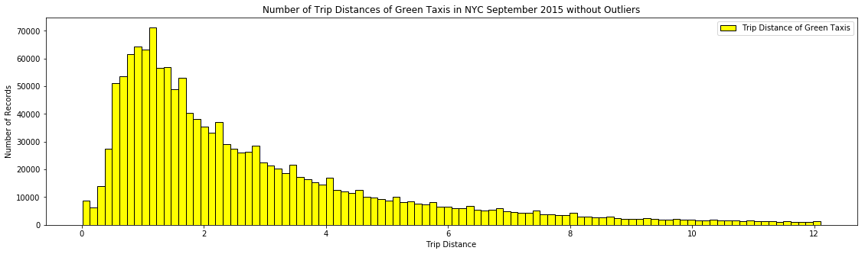
HISTOGRAM
Number of Trip Distances of Green Taxis in NYC September 2015 without Outliers
Observations on the Structure:
1) Right-skew (median smaller than its mean). 2) The highest frequency of Trip distances occur at about 1.6 miles. 3) Gradual decrease in frequency after 1.6 miles.
01
The hypothesis:
People definitely prefer short distances over long distances. That's probably because of two reasons: Longer distances are extremely expensive. NY subway or driving their own car would be much cheaper. Secondly, longer distances could also mean increased traffic and longer trip times. NY subway would be a faster means of transport.
02

Slide 4
Mean and median trip distance grouped by hour of day
Observation and Hypothesis (Graph in Jupyter Notebook)
Hypothesis 2
Observation
Hypothesis 1
The longest rides are taken early in the morning. Evenings have comparatively longer rides too. Hours between 9 and 7 have short rides taken.
People take cabs to work to ensure they reach on time. Also, they take cab back home when it's really late.
People do not take cab back home from work, if they leave on time. Since probably there is no urgency of reaching on time, they take the subway or other form of public transport.

Slide 5
Recommendation Based on Additional Analysis on Airport Trips
As per THE PORT AUTHORITY OF NY & NJ's monthly summary (DEC 2015), There are about 4.7 Million Passengers that travelled. As per the report about 890,000 passengers used Airport Coach(Bus), Taxis and Air Trains. The taxis dispatched were 202,000 approx.
Now, Assuming the numbers for September 2015 are 80% that of Dec 2015 (Since Dec is a high travel season usually). The numbers would now be: 3.76 total passengers. 708,000 passengers used Airport Coach(Bus), Taxis and Air Trains. The taxis dispatched were 161,000.
One needs to account for Ubers,Lyfts and other ride hailing companies too which is not stated in the report. As per https://www.businessinsider.com/uber-taxis-new-york-ridership-2017-10, these companies account for about 84% market share in 2015. Using the same market share numbers, if 161,000 taxis dispatched accounted for 16% market share, 84% accounts to 1.01 Million rides.
Of the total taxis dispatched and ride hailing cabs dispatched are about 1.17 million. Assuming only 20% of these travel from/to the green taxis zone, that's still 234K rides. While green taxis account for only 4276 rides (1.8%)!
The assumption is green taxis are not so popular, because ride hailing cabs (uber and lyft) are more convinient and cheaper.
So the Recommendation is to slash fare rates for airport trips to tap into this large market segment!!
Source: https://www.panynj.gov/airports/pdf/JFK_Dec_2015.pdf

Slide 6
Random Forest Regression
Predictive model for tip as a percentage of the total fare
DATA CLEANING
EDA
& ASSUMPTION CHECK
TRAINING AND TEST
MODEL FIT
CONCLUSION
As shown in Slide 2
Few Variables dropped due to:
Multi collinearity
Low correlation with Tip%
(70:30 Split)
One hot encoding done before the split
Random Forest Regression fitted on training data
Number of trees: 3
Residual plots are good
Accuracy is high.
The MSE = 0.0001 degrees

Slide 7
Pick up Point Analysis
A Function, given a point P, to Find the K Trip Origination Points Nearest P with Time Consideration
HAVERSINE FORMULA USED
https://www.movable-type.co.uk/scripts/latlong.html
PARAMETERS USED
Pick up Location and Time
PERFORMANCE
The code seems efficient and takes about a fraction of a second to run on the entire dataset. It shall do well on larger data sets too. (took 0.24 seconds when I tested)

Slide 8
FINAL THOUGHTS (RECOMMENDATION AND FUTURE SCOPE)
01
Recommendation 1:
Drop Fare Amounts for Airport Trips and try capturing larger market share
02
Recommendation 2:
Increase number of taxis at locations across NYC as per hour of the day. Also, cash tips need be tracked as well.
03
FUTURE SCOPE 1:
Analyze data with other months and more importantly later year. Is there a drop is usage because of Uber/Lfyt?
04
FUTURE SCOPE 2:
Anomaly Detection

